Slide 1
Live Classroom
Module 3 – Correlation and Simple Linear Regression

Slide 2
Topics
Announcements
Scatterplots
Correlation
Simple Linear Regression
Quantities from the F-distribution

Slide 3
Announcements
Next week’s live classroom will be at the usual time!
Wednesday July 27 from 7-9 PM EST.
We will discuss the final project.
The week 5 live classroom will be a day later!
Thursday, August 4 from 6-8 PM EST.
We will allow you to submit quiz 5 and assignment 5 a day later (i.e., on Wednesday instead of Tuesday).
I will update the dates on the course website and post an announcement.

Slide 4
Introduction
This module is focused on understanding the relationship or association between two continuous or quantitative factors.
Weight versus height.
Family income and child’s SAT score.
Minutes spent studying and test score.
We will learn to
Visualize the relationship (via scatterplots).
Describe the relationship via numerical summaries (via correlation and simple linear regression).
Use information about a sample to make inferences about a population.

Slide 5
Scatterplots
Use plot() function to visualize the relationship between two quantitative variables
plot(data$explanatoryvariable, data$responsevariable)
Use main, xlab, and ylab to label the plot appropriately
Use xlim and ylim to control x and y axes, respectively
Change the type of point using pch and/or the color of the points using col
Change the size of the points or the labels using cex, cex.axis, or cex.main
Use scatterplot to describe the form, direction, and strength of the relationship. Can also be used to identify outliers.

Slide 6
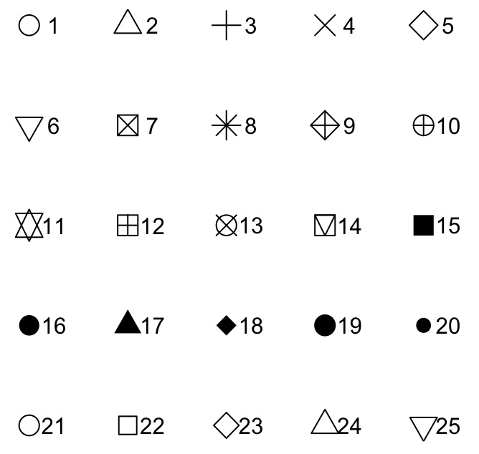
Plot options for pch
pch=# in plot function call

Slide 7
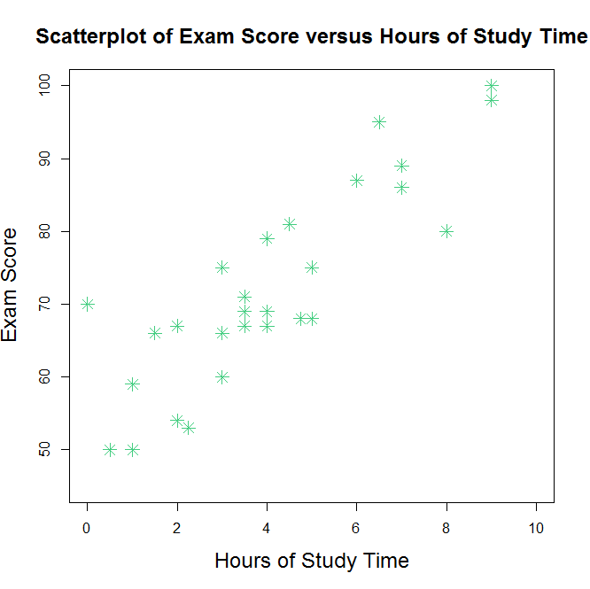
Example- Study Time and Exam Score
plot(examdata$Hours,examdata$Exam, main="Scatterplot of Exam Score versus Hours of Study Time", xlab = "Hours of Study Time", ylab="Exam Score", xlim=c(0, 10), ylim=c(45, 100), pch = 8, col="seagreen3", cex=1.5, cex.lab = 1.5, cex.main = 1.5)

Slide 8
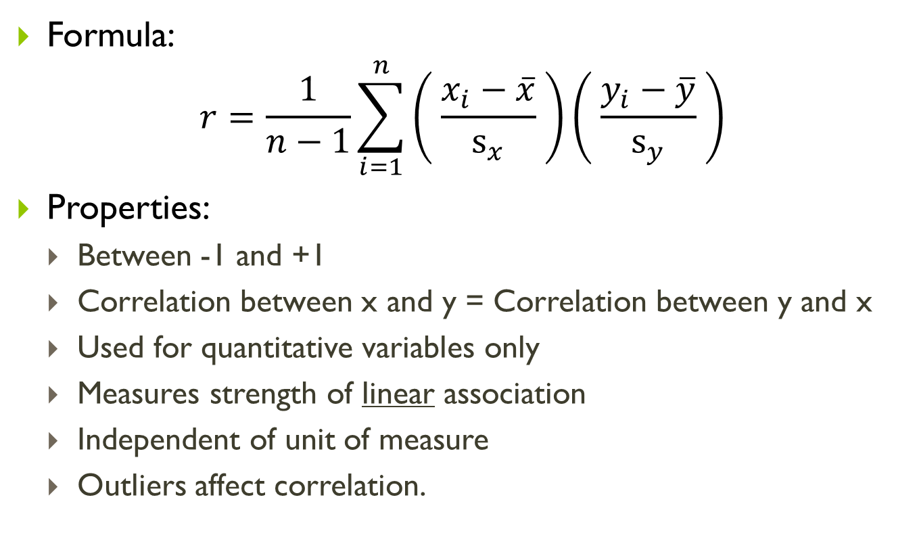
Correlation
Formula:
$$r=\frac{1}{n−1}\sum_{i=1}^{n}{\left( \frac{x_{i}−\overline{x}}{s_{x}} \right)\left( \frac{y_{i}−\overline{y}}{s_{y}} \right)}$$
Properties:
Between -1 and +1
Correlation between x and y = Correlation between y and x
Used for quantitative variables only
Measures strength of linear association
Independent of unit of measure
Outliers affect correlation.
Notes:
(1) The correlation takes on values between -1 and +1. The correlation is positive (> 0) when there is a positive association between variables and negative (< 0) then there is a negative association between variables. A correlation of 0 indicates that there is not an association between the variables. The closer the value of the correlation to the extremes (-1 or +1), the stronger the associations between the variables (the closer the points lie to a straight line). In fact, a correlation of -1 or +1 indicates that the points on a scatterplot lie perfectly along a straight line.
When the correlation is greater than 0, the variables can be described as positively correlated (this is the same as saying there is a positive association between the variables). Similarly, when the correlation is less than 0, the variables can be described as negatively correlated (this is the same as saying there is a negative association between the variables). Variables are said to be uncorrelated when the correlation is 0 (this is the same as saying there is not a linear association between the variables).
(2) The correlation between variables $x$ and $y$ is the same as the correlation between variables $y$ and $x$. That is, the calculation of the correlation is independent of which variable is selected as the explanatory variable and which is selected as the response variable.
(3) Correlations can be computed between paired values of two quantitative variables. You cannot use correlation to compute the correlation between gender and SAT scores, for example since gender is not quantitative (it is qualitative).
(4) The correlation coefficient does not have units and it is independent of unit of measure of variables $x$ and $y$. If for a particular dataset of n people, the correlation between height (in meters) and weight (in kg) is 0.85, then the correlation between height (in inches) and weight (in pounds) will also be 0.85.
(5) Correlation measures the strength of a linear relationship only. Correlation should not be used to describe a curved relationship – even if the association is strong.
(6) Outliers affect correlation. Correlation in the presence of outliers should be interpreted with caution.

Slide 9
Correlation - Inference
Though the sample correlation coefficient is useful in helping describe the relationship in a sample, we are often interested in using the data collected from a sample to make conclusions about the correlation between the same parameters in the population.
The sample correlation, r, is a point estimate for the population correlation coefficient, ρ (read “rho”).
In general, formal tests of hypotheses concerning ρ seek to determine whether or not there is a linear association between the variables in the population (we usually test whether ρ = 0).
Notes:
(1) The correlation takes on values between -1 and +1. The correlation is positive (> 0) when there is a positive association between variables and negative (< 0) then there is a negative association between variables. A correlation of 0 indicates that there is not an association between the variables. The closer the value of the correlation to the extremes (-1 or +1), the stronger the associations between the variables (the closer the points lie to a straight line). In fact, a correlation of -1 or +1 indicates that the points on a scatterplot lie perfectly along a straight line.
When the correlation is greater than 0, the variables can be described as positively correlated (this is the same as saying there is a positive association between the variables). Similarly, when the correlation is less than 0, the variables can be described as negatively correlated (this is the same as saying there is a negative association between the variables). Variables are said to be uncorrelated when the correlation is 0 (this is the same as saying there is not a linear association between the variables).
(2) The correlation between variables $x$ and $y$ is the same as the correlation between variables $y$ and $x$. That is, the calculation of the correlation is independent of which variable is selected as the explanatory variable and which is selected as the response variable.
(3) Correlations can be computed between paired values of two quantitative variables. You cannot use correlation to compute the correlation between gender and SAT scores, for example since gender is not quantitative (it is qualitative).
(4) The correlation coefficient does not have units and it is independent of unit of measure of variables $x$ and $y$. If for a particular dataset of n people, the correlation between height (in meters) and weight (in kg) is 0.85, then the correlation between height (in inches) and weight (in pounds) will also be 0.85.
(5) Correlation measures the strength of a linear relationship only. Correlation should not be used to describe a curved relationship – even if the association is strong.
(6) Outliers affect correlation. Correlation in the presence of outliers should be interpreted with caution.

Slide 10
Correlation
Use cor() function to calculate sample correlation coefficient
cor(data$explanatoryvariable, data$responsevariable)
Use cor.test() function to perform testing
cor.test(data$explanatoryvariable, data$responsevariable, alternative =[alternative], method = [method], conf.level = [confidence level])
[alternative] = “less”, “greater” or “two.sided”
[method] = "pearson", "kendall“ or "spearman“
FYI (optional material) : https://www.statisticssolutions.com/correlation-pearson-kendall-spearman/

Slide 11
Example- Study Time and Exam Score
Calculate sample correlation
cor(examdata$Hours,examdata$Exam)
Perform testing
cor.test(examdata$Hours,examdata$Exam)

Slide 12
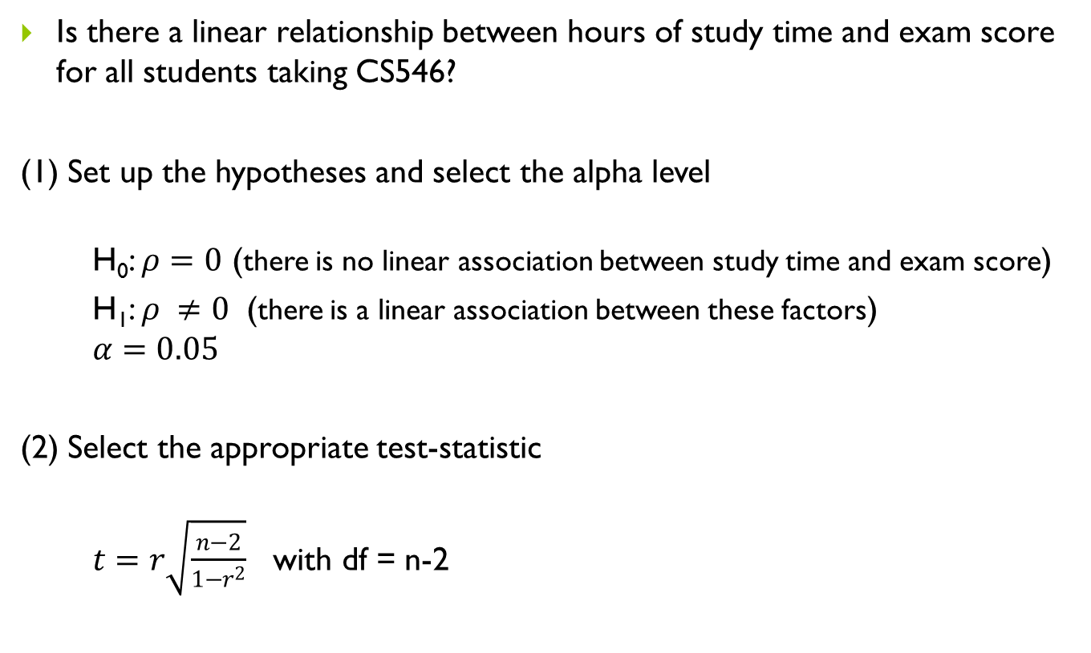
Example- Study Time and Exam Score
Is there a linear relationship between hours of study time and exam score for all students taking CS546?
(1) Set up the hypotheses and select the alpha level
H₀: $ρ=0$ (there is no linear association between study time and exam score)
H₁: $ρ ≠0$ (there is a linear association between these factors)
$$α=0.05$$
(2) Select the appropriate test-statistic
$t=r\sqrt{\frac{n−2}{1−r^{2}}}$ with df = n-2

Slide 13

Example- Study Time and Exam Score
(3) State the decision rule
Decision Rule: Reject H₀ if $p$≤ $α.$ Otherwise, do not reject H₀

Slide 14
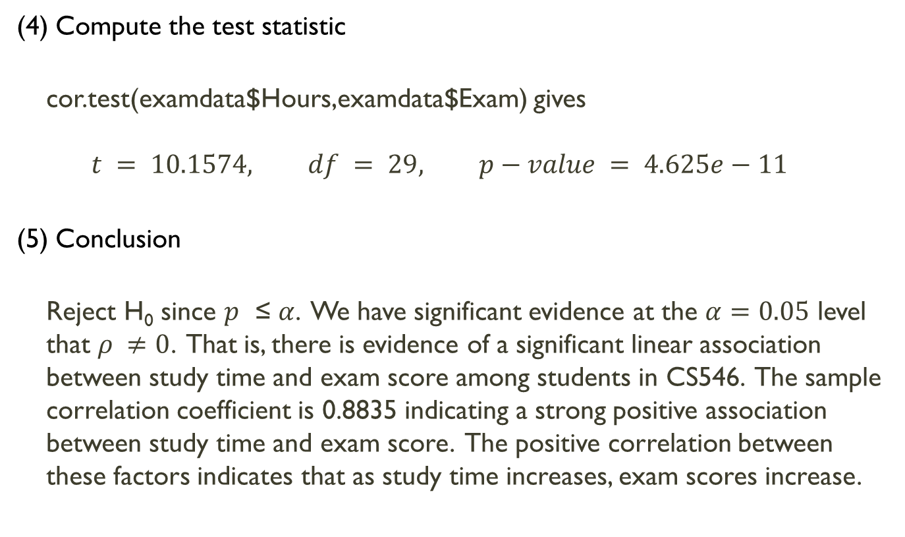
Example- Study Time and Exam Score
(4) Compute the test statistic
cor.test(examdata$Hours,examdata$Exam) gives
$$t = 10.1574, df = 29, p−value = 4.625e−11$$
(5) Conclusion
Reject H₀ since $p$ ≤ $α$. We have significant evidence at the $α=0.05$ level that $ρ ≠0$. That is, there is evidence of a significant linear association between study time and exam score among students in CS546. The sample correlation coefficient is 0.8835 indicating a strong positive association between study time and exam score. The positive correlation between these factors indicates that as study time increases, exam scores increase.

Slide 15
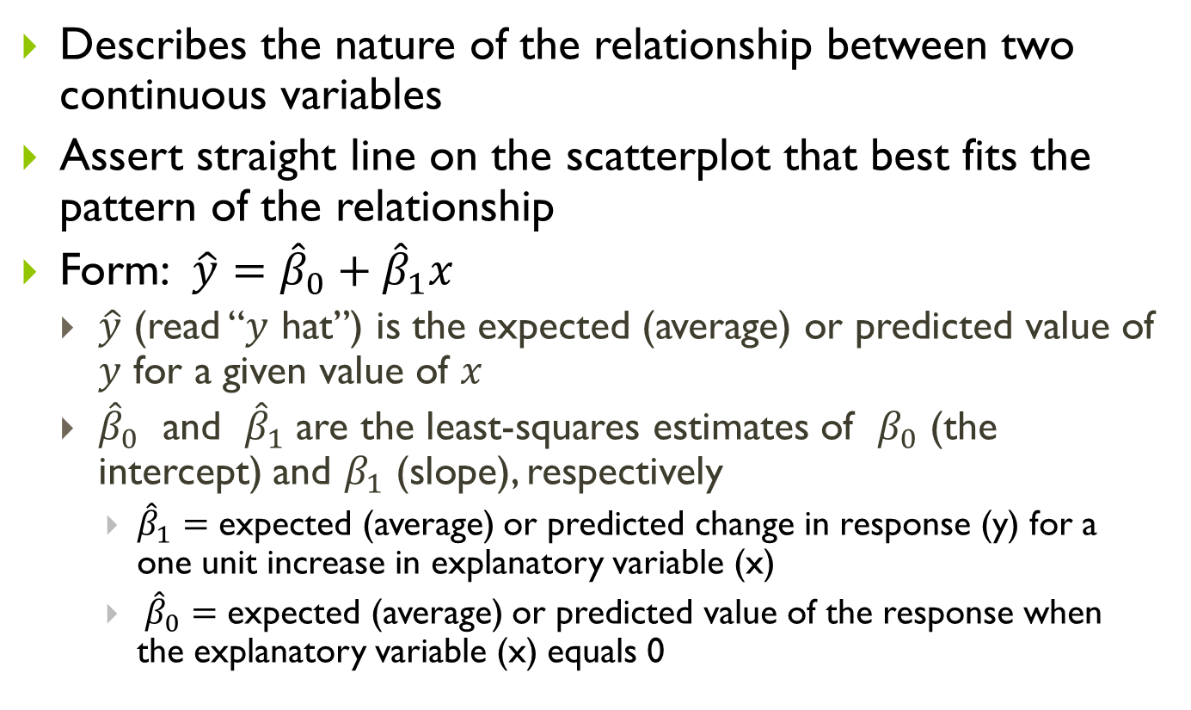
Simple Linear Regression
Describes the nature of the relationship between two continuous variables
Assert straight line on the scatterplot that best fits the pattern of the relationship
Form: $\hat{y}={\hat{β}}_{0}+{\hat{β}}_{1}x$
$\hat{y}$ (read “$y$ hat”) is the expected (average) or predicted value of $y$ for a given value of $x$
${\hat{β}}_{0}$ and ${\hat{β}}_{1}$ are the least-squares estimates of $β_{0}$ (the intercept) and $β_{1}$ (slope), respectively
${\hat{β}}_{1}=$ expected (average) or predicted change in response (y) for a one unit increase in explanatory variable (x)
${\hat{β}}_{0}=$ expected (average) or predicted value of the response when the explanatory variable (x) equals 0
Notes:
Linear relationships between two quantitative variables are quite common and relatively easy to express mathematically. This was evident above when we examined correlation. Correlation helped us quantify the direction and strength of the relationship between two quantitative variables. If a linear relationship exists, we can also take it one step further by describing the nature of the relationship between the variables using simple linear regression (SLR). Using this technique, we assert a straight line on the scatterplot that represents the best fitting line to the data that captures the pattern of the relationship. In SLR, we must select one variable to be the response variable and the other to be the explanatory variable. The equation of the regression line takes on a form which represents how the response variable $y$changes as explanatory variable $x$changes. Not only does SLR allow us to quantify the relationship between our response variable and our explanatory variable, it also allows us a tool for predicting the response of a new observation with a given value for $x$ or what the average response is for observations with a specific value for the explanatory variable (based on the pattern of the data).

Slide 16
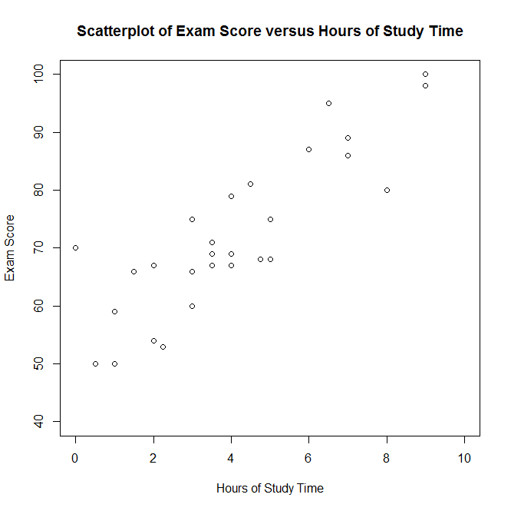
Example – What’s the best fit line?
Notes:
0.8835

Slide 17
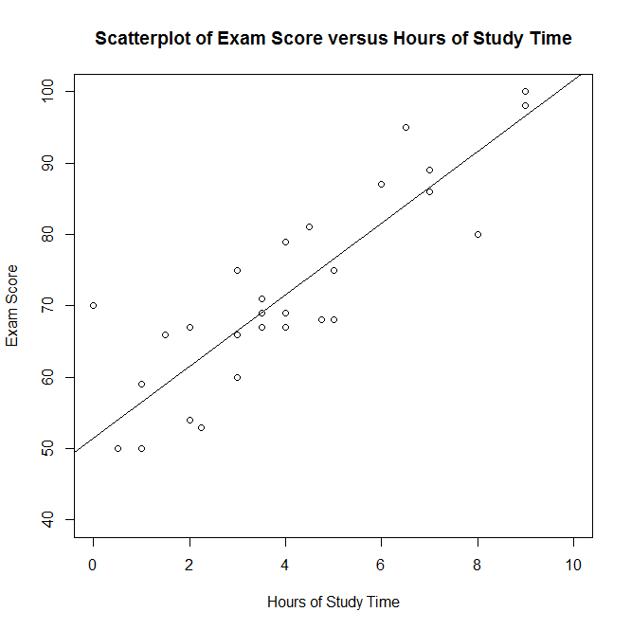

Example – What’s the best fit line?
$$\hat{y}=51.51+5.012x$$
Notes:
0.8835

Slide 18
Example – What’s the best fit line?
$$\hat{y}=51.51+5.012x$$
Notes:
One way of thinking about this is that we want to minimize the vertical distance between each of the points and the regression line. We can visualize this in the scatterplot below. That is, we want to minimize the length of all of the green dotted lines that represent the distance between regression line and the points. There are several ways of doing so. The most common way is to minimize the sum of the squares of the distances between the points and the regression line. This approach is called the least-squares method.
The least-squares method has gained popularity due to its simplicity and the ease by which you can calculate the equation using just the correlation between the variables and each variable’s mean and standard deviation.

Slide 19
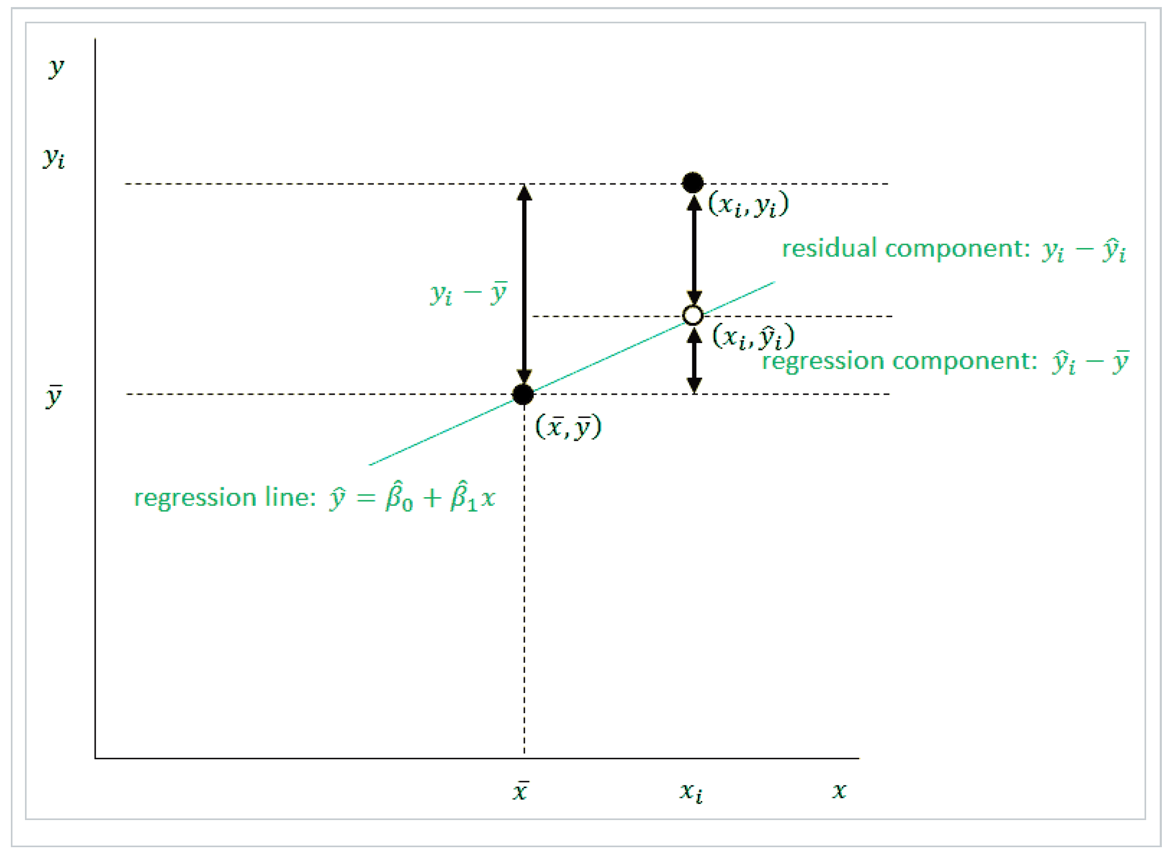
Simple Linear Regression

Slide 20
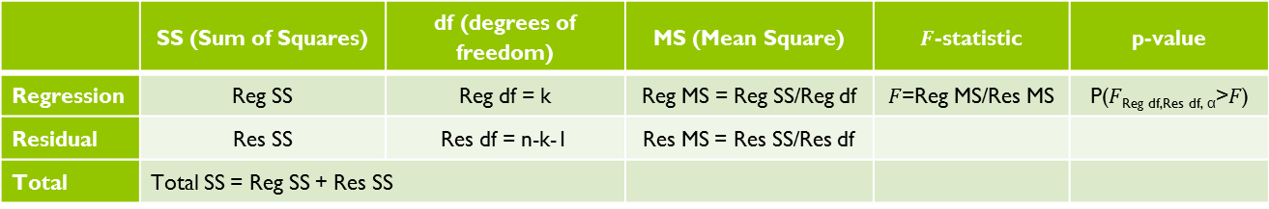
ANOVA table
 | SS (Sum of Squares) | df (degrees of freedom) | MS (Mean Square) | $F$-statistic | p-value
Regression | Reg SS | Reg df = k | Reg MS = Reg SS/Reg df | $F$=Reg MS/Res MS | P($F$_{Reg df,Res df, α}>$F$)
Residual | Res SS | Res df = n-k-1 | Res MS = Res SS/Res df
Total | Total SS = Reg SS + Res SS

Slide 21
Simple Linear Regression
Use lm() function to perform regression
lm(data$response~data$explanatory)
Use abline() function on the lm() result to plot the regression line on the scatterplot
Use anova() function on the lm() result to obtain the ANOVA table (F-test)
Use summary() function on the lm() result to obtain the beta coefficients (t-test), R-squared value, F-statistic
Use confint() on the lm() result to obtain confidence intervals for the regression coefficients

Slide 22
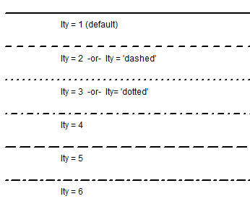
abline() function
Control the line type by lty=#
Control color using col = “color”

Slide 23
Quantities from the F-distribution
Calculating probabilities from F-statistics
Use the pf() function to calculate the area to the left of a given F-statistic
pf([F statistic], df1 = [degrees of freedom of the numerator], df2 = [degrees of freedom of the denominator])
Calculating F-statistics from probabilities
Use the qf() function to find the F-statistic with the specified area to the left
qf([area], df1 = [degrees of freedom of the numerator], df2 = [degrees of freedom of the denominator])

Slide 24
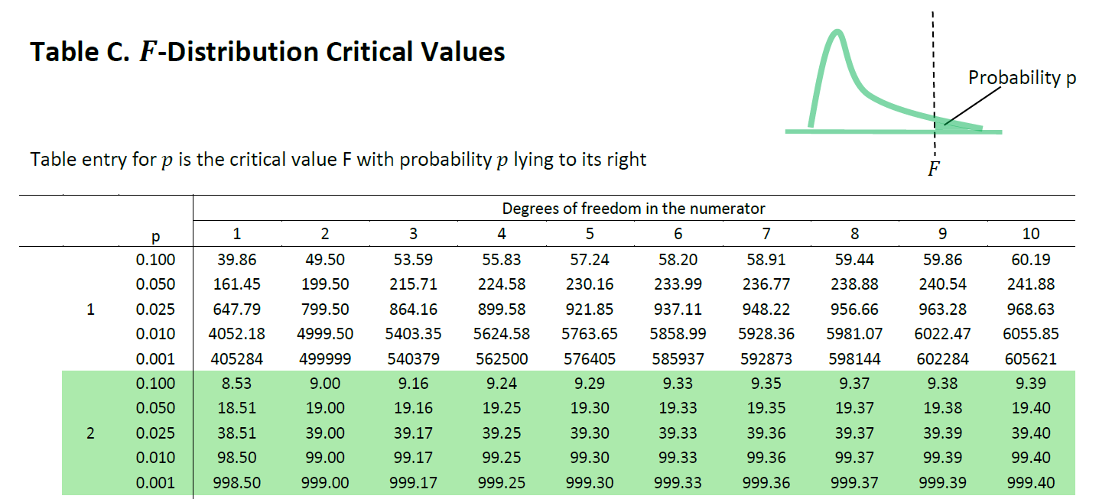
pf(18.51, df1=1,df2=2)
R gives 0.95 (area to the left of F=18.51)
qf(0.95, df1=1,df2=2)
R gives back 18.51

Slide 25
Example- Study Time and Exam Score
m<-lm(examdata$Exam~examdata$Hours)
plot(examdata$Hours,examdata$Exam)
abline(m)
anova(m)
summary(m)
confint(m, level = 0.95)

Slide 26

Example- Study Time and Exam Score – F-test
Is there a linear relationship between hours of study time and exam score for all students taking CS546?
(1) Set up the hypotheses and select the alpha level
H₀:${ β}_{1}=0$ (there is no linear association between study time and exam score)
H₁:${ β}_{1} ≠0$ (there is a linear association between these factors)
$$α=0.05$$
(2) Select the appropriate test-statistic
$F=\frac{MS Reg}{MS Res}$ with 1 and n-2 degrees of freedom

Slide 27
Example- Study Time and Exam Score – F-test
(3) State the decision rule
Decision Rule: Reject H₀ if $p$≤ $α.$ Otherwise, do not reject H₀

Slide 28
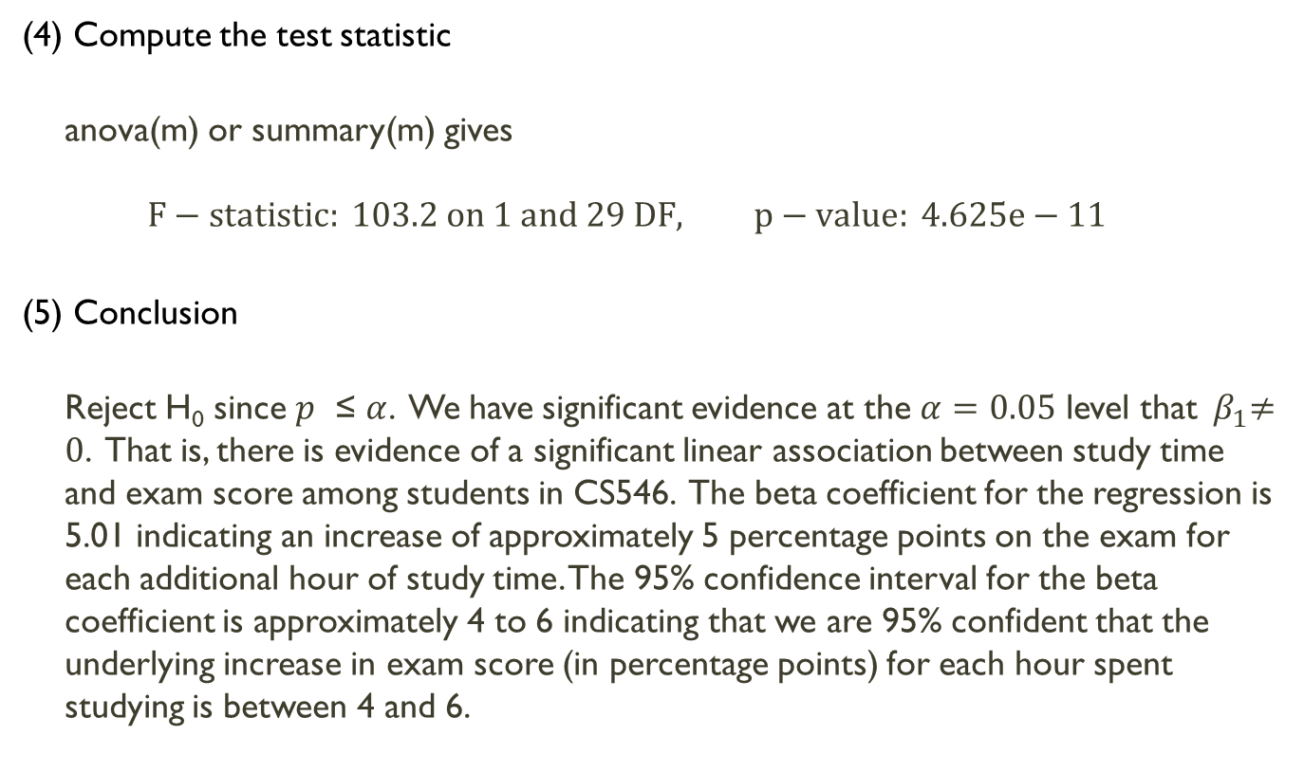
Example- Study Time and Exam Score – F-test
(4) Compute the test statistic
anova(m) or summary(m) gives
$$F−statistic: 103.2 on 1 and 29 DF, p−value: 4.625e−11$$
(5) Conclusion
Reject H₀ since $p$ ≤ $α$. We have significant evidence at the $α=0.05$ level that${ β}_{1}≠0$. That is, there is evidence of a significant linear association between study time and exam score among students in CS546. The beta coefficient for the regression is 5.01 indicating an increase of approximately 5 percentage points on the exam for each additional hour of study time. The 95% confidence interval for the beta coefficient is approximately 4 to 6 indicating that we are 95% confident that the underlying increase in exam score (in percentage points) for each hour spent studying is between 4 and 6.

Slide 29
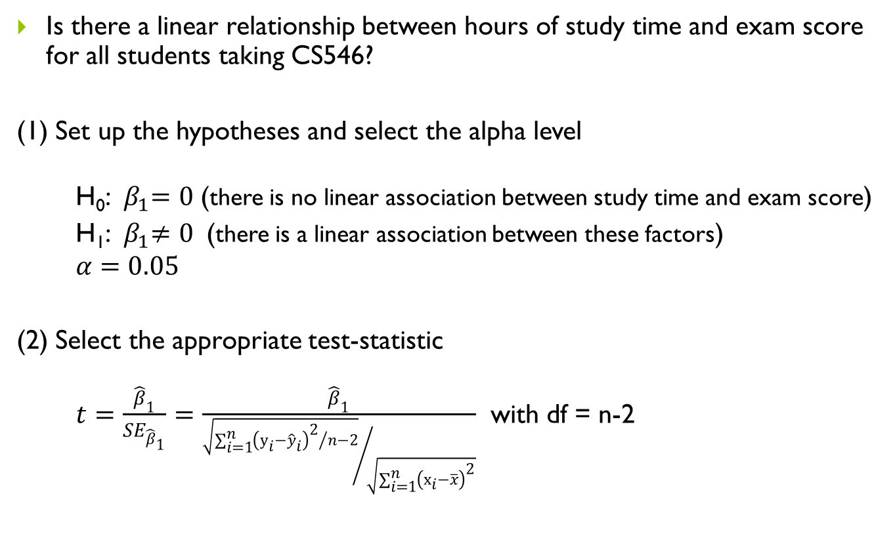
Example- Study Time and Exam Score – t-test
Is there a linear relationship between hours of study time and exam score for all students taking CS546?
(1) Set up the hypotheses and select the alpha level
H₀:${ β}_{1}=0$ (there is no linear association between study time and exam score)
H₁:${ β}_{1}≠0$ (there is a linear association between these factors)
$$α=0.05$$
(2) Select the appropriate test-statistic
$t=\frac{{\hat{β}}_{1}}{{SE}_{{\hat{β}}_{1}}}=\frac{{\hat{β}}_{1}}{{\sqrt{{\sum_{i=1}^{n}{{\left(y_{i}−{\hat{y}}_{i}\right)}^{2}}}/{n−2}}}/{\sqrt{\sum_{i=1}^{n}{{\left(x_{i}−\overline{x}\right)}^{2}}}}}$ with df = n-2

Slide 30
Example- Study Time and Exam Score – t-test
(3) State the decision rule
Decision Rule: Reject H₀ if $p$≤ $α.$ Otherwise, do not reject H₀

Slide 31
Example- Study Time and Exam Score – t-test
(4) Compute the test statistic
summary(m)
$$t = 10.16, df = 29, p−value = 4.625e−11$$
(5) Conclusion
Reject H₀ since $p$ ≤ $α$. We have significant evidence at the $α=0.05$ level that${ β}_{1}≠0$. That is, there is evidence of a significant linear association between study time and exam score among students in CS546. The beta coefficient for the regression is 5.01 indicating an increase of approximately 5 percentage points on the exam for each additional hour of study time. The 95% confidence interval for the beta coefficient is approximately 4 to 6 indicating that we are 95% confident that the underlying increase in exam score (in percentage points) for each hour spent studying is between 4 and 6.

Slide 32
Things to note
Correlation between x and y is independent of order
Regression and correlation will give same conclusion, but regression coefficient depends on which variable is specified as explanatory
In regression, t-test and F-test give same result (in SLR F = t²) – same p-value
T-test from correlation and t-test from regression are equivalent and also give same result

